Slide 1
PowerShell for the SQL Server DBA
Chrissy LeMaire, Rob Sewell & Klaas Vandenberghe

Slide 2

Chrissy LeMaire
PowerShell MVP
@cl
Creator of dbatools.io
PASS PowerShell VG, Belgian PowerShell UG
DBA with General Dynamics IT at NATO Spec Ops HQ

Slide 3
Rob Sewell
PowerShell MVP
@sqldbawithbeard
Creator of SQLDiagAPI
PASS PowerShell VG, SQL Saturday Exeter
PowerShell Consultant and Trainer

Slide 4

Klaas Vandenberghe
@powerdbaklaas
SQL Server DBA
PowerShell early adopter
Major Contributor of dbatools

Slide 5
Agenda
PowerShell essentials for the SQL Server DBA
Introduction to the SqlServer provider
Introduction to dbatools
Lunch
PowerShell in practice: Gather your servers
PowerShell in practice: Checking SQL Server through the ages
PowerShell Pester in practice: Checking your SQL Servers right now
dbatools development in practice: The story of Get-DbaWaitStatistic
SQL PowerShell administration in practice: Scheduling a PS task in SQL Agent

Slide 6
PowerShell Essentials for the SQL Server DBA
What do I need to know to get started?
Notes:
So you’re all here because you want to start managing your SQL Servers with PowerShell?
You could choose to become a PowerShell expert first. We have some good books that will teach you everything there is to know. But you’ll spend 2 to 3 months before you touch your first SQL Server. That’s not what we want.
On the other extreme, you can go to work tomorrow or the day after and start up a Shell, but you’ll be stuck within 2 minutes.
We’ll meet in the middle and go through some essentials, some topics you will be confronted with, maybe trip over.

Slide 7
What is PowerShell
Shell
command-line interpreter
Language
Tool for working with management objects
for remote administration
<> Host console

Slide 8
PowerShell Hosts
How do I talk to PowerShell?
PowerShell consoleHost
PowerShell ISE
VS Code
PowerShell
mssql
Visual Studio
3rd party
Quest PowerGUI
Sapien PowerShell Studio
Idera PowerShellPlus

Slide 9
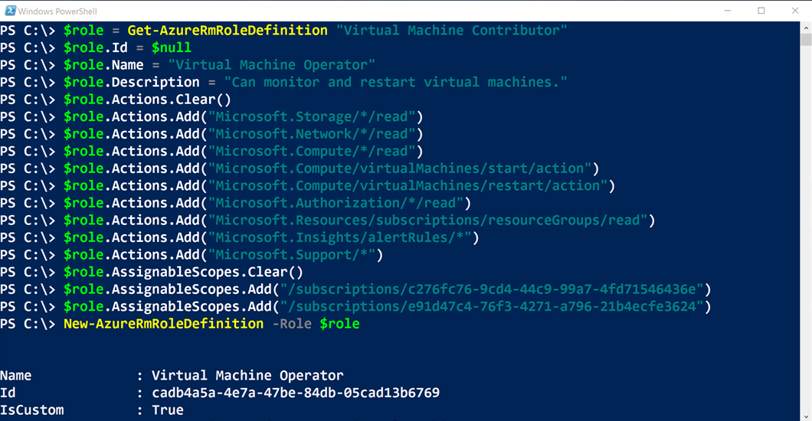
PowerShell Console

Slide 10
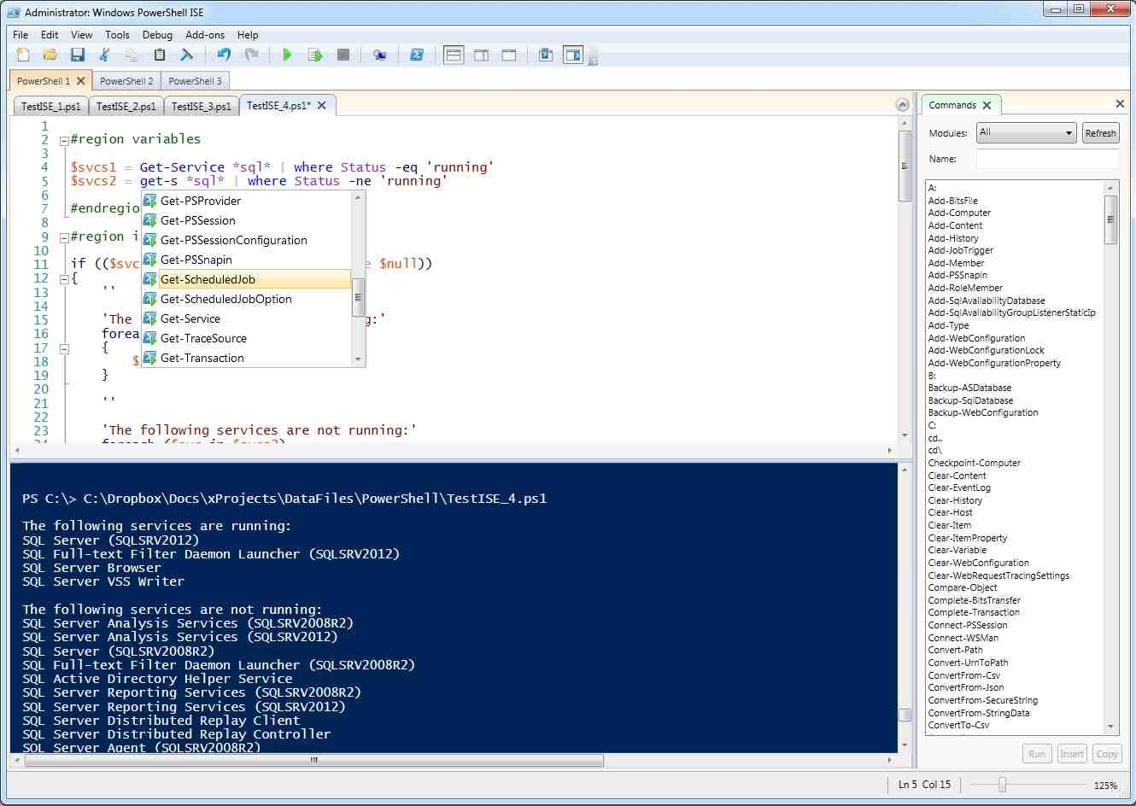
Microsoft PowerShell ISE

Slide 11
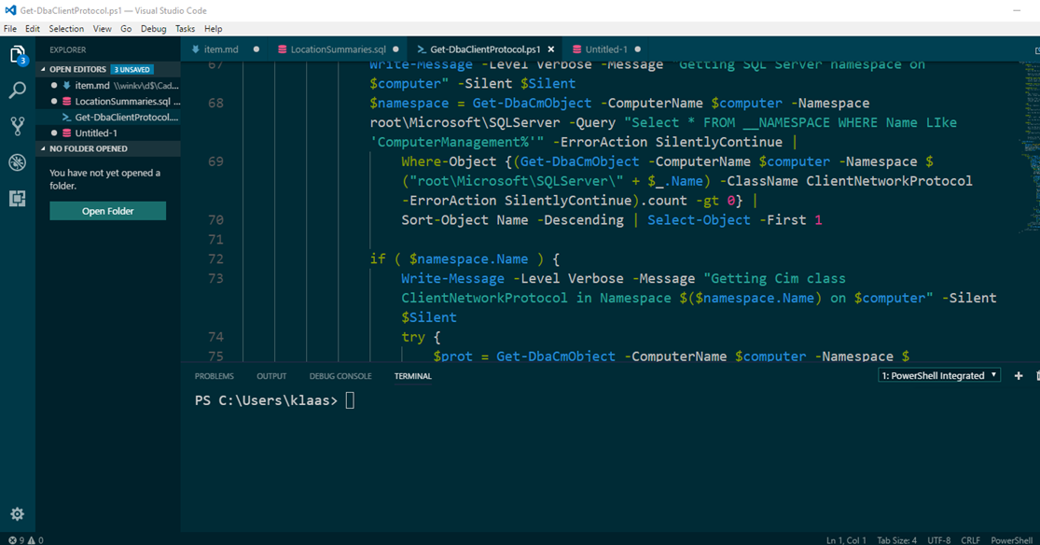
VS Code

Slide 12
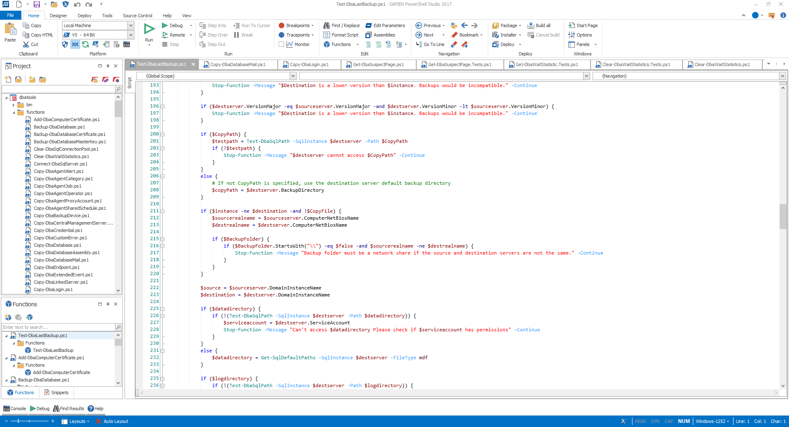
Sapien PowerShell Studio

Slide 13
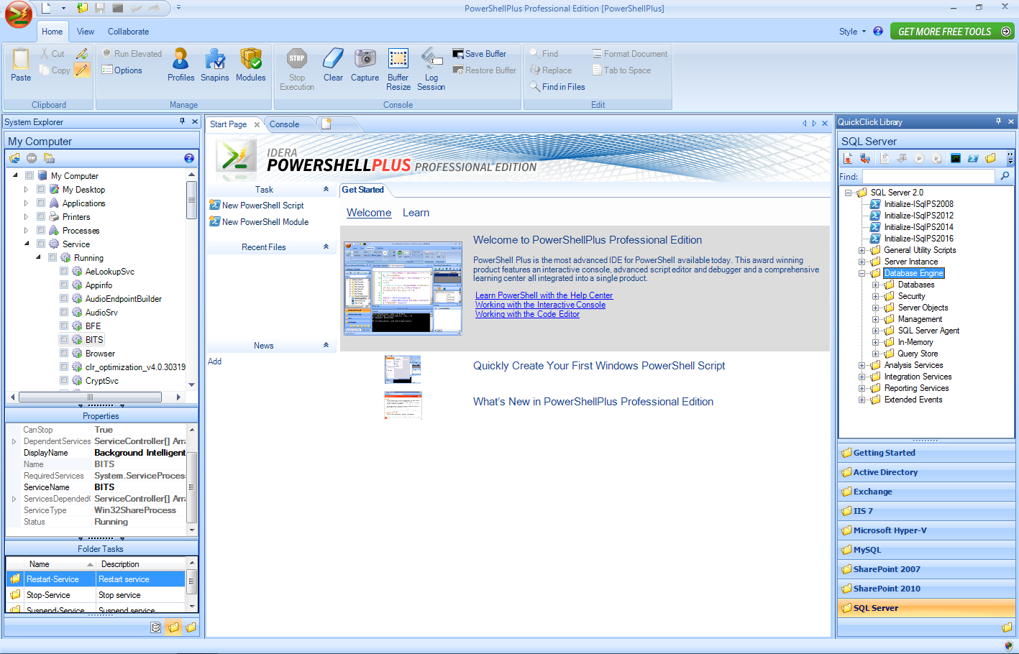
Idera PowerShell Plus

Slide 14
One Shell to Rule Them All
What kingdoms can I reign with PowerShell?
Exchange
SharePoint
Active Directory
File system
Registry
IIS
SQL Server

Slide 15
4 types of commands
Cmdlets
.Net class in DLL
Compiled code loaded in the process
=> most efficient commands
Functions
Named piece of code
=> most commonly written
Scripts
Code in a text file
Native Win32 executables
Notes:
A cmdlet is implemented by a .NET class that
derives from the Cmdlet base class in the PowerShell Software Developers Kit (SDK).
NOTE Building cmdlets is a developer task and requires the PowerShell SDK. This SDK is
freely available for download from Microsoft and includes extensive documentation along with
many code samples. Our goal is to coach you to effectively use and script in the PowerShell
environment, so we’re not going to do much more than mention the SDK in this book.
This category of command is compiled into a dynamic link library (DLL) and then loaded into
the PowerShell process, usually when the shell starts up. Because the compiled code is loaded
into the process, it’s the most efficient category of command to execute.
FUNCTIONS
The next type of command is a function. This is a named piece of PowerShell script code that
lives in memory while the interpreter is running and is discarded on exit. Functions consist of
user-defined code that’s parsed once when defined. This parsed representation is preserved so
it doesn’t have to be reparsed every time it’s used.
SCRIPTS
A script command is a piece of PowerShell code that lives in a text file with a .ps1 extension.
These script files are loaded and parsed every time they’re run, making them somewhat
slower than functions to start (although once started, they run at the same speed). In terms
of parameter capabilities, shell function commands and script commands are identical.
NATIVE COMMANDS (APPLICATIONS)
The last type of command is called a native command. These are external programs (typically
executables) that can be executed by the operating system. Because running a native
command involves creating a whole new process for the command, native commands are the
slowest of the command types. Also, native commands do their own parameter processing and
so don’t necessarily match the syntax of the other types of commands.
Native commands cover anything that can be run on a Windows computer, so you get a
wide variety of behaviors. One of the biggest issues is when PowerShell waits for a command
to finish but it just keeps on going.

Slide 16
Commands to remember
First Aid Cmdlets
Get-Command
Get-Help
Get-Member

Slide 17
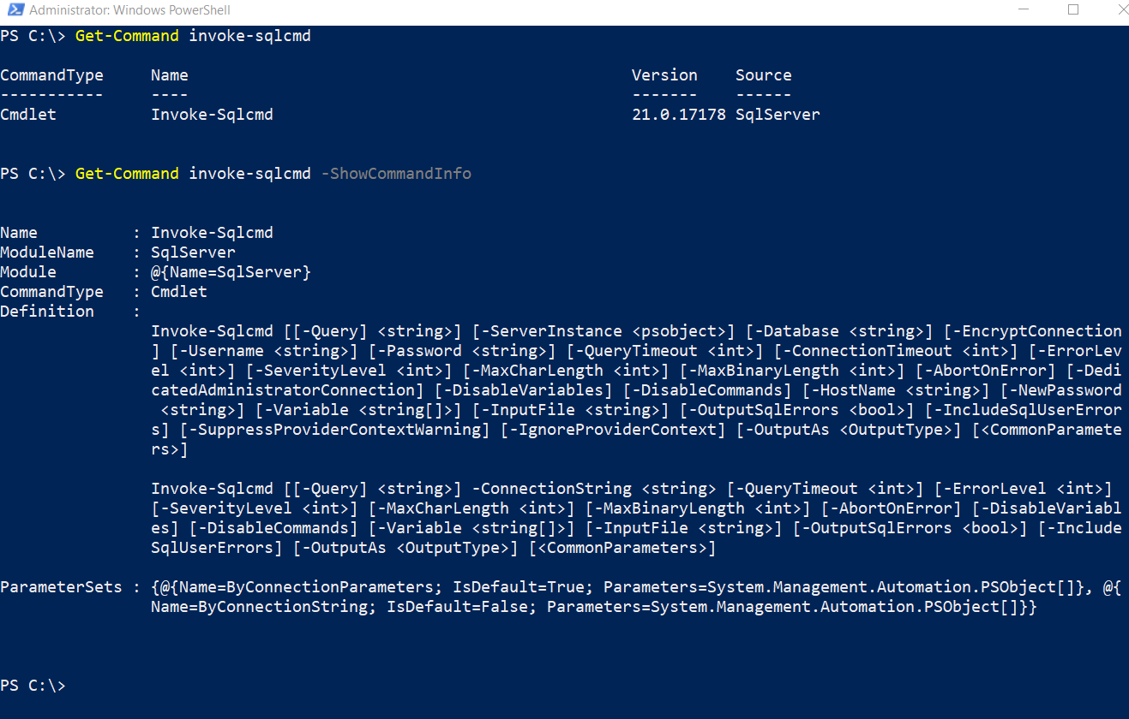

Slide 18
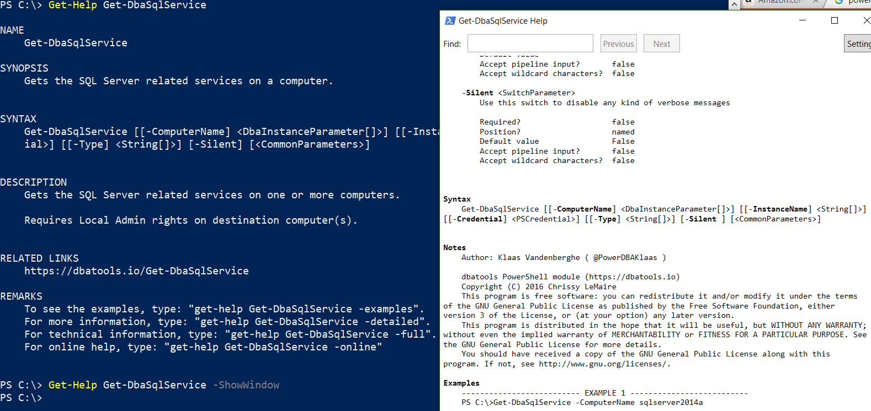

Slide 19
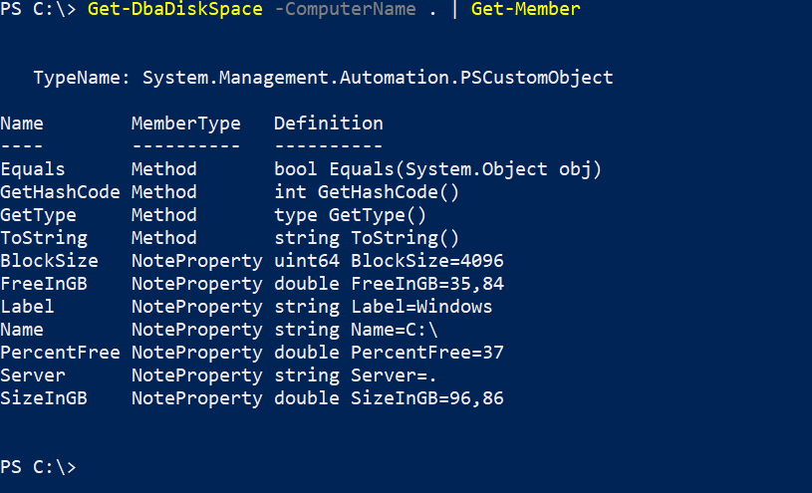

Slide 20
Providers & Drives
Get-PSProvider
Get-PSDrive
Navigate through Registry or SQL Server

Slide 21
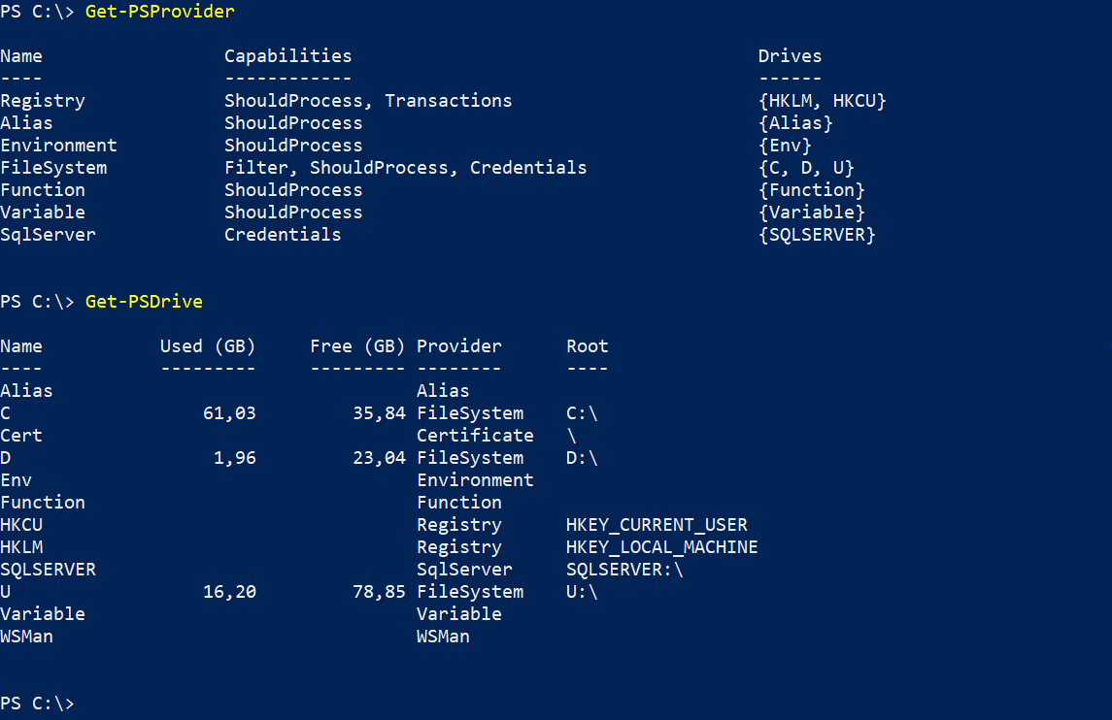

Slide 22
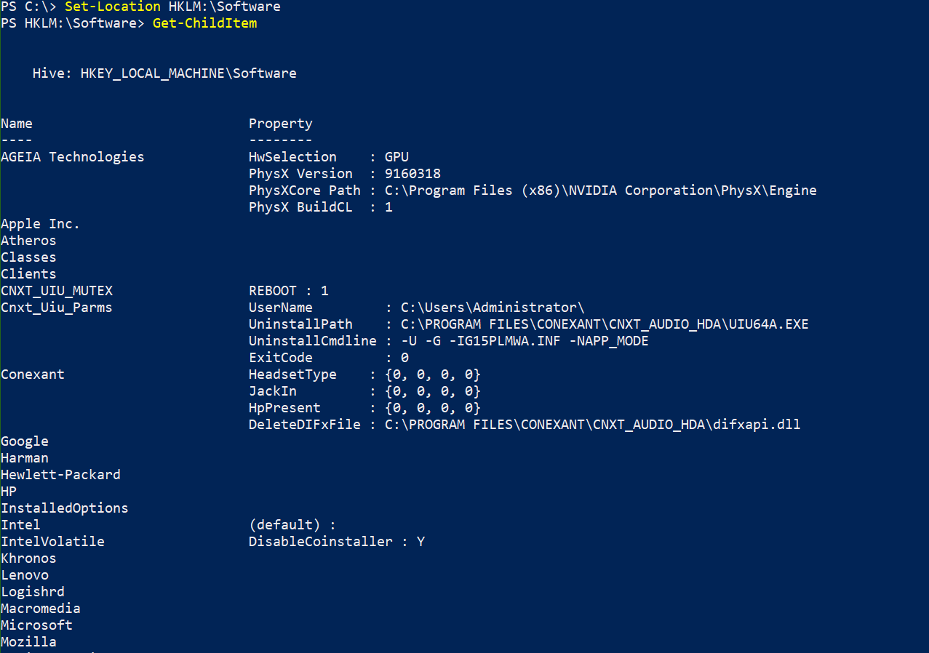

Slide 23
Modules
Introduced in PowerShell v2
Autoloading in PowerShell v3
Package with a set of functions to work with a certain environment
Reuse code from others
Usually copy-paste and modify
Module is written in a way that code can be reused
$env:PSmodulePath –Split ‘;’
PowerShellGet module & PSGallery PS V5
Install-Module, Import-Module, …

Slide 24
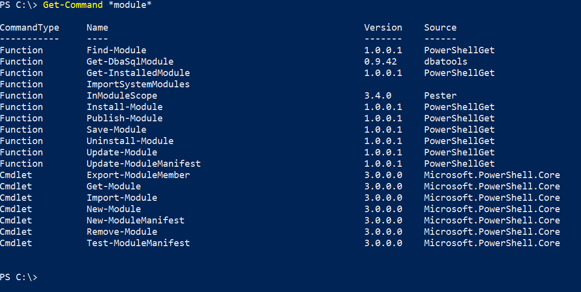
Notes:
Again: Get-Command , this time with wildcards

Slide 25
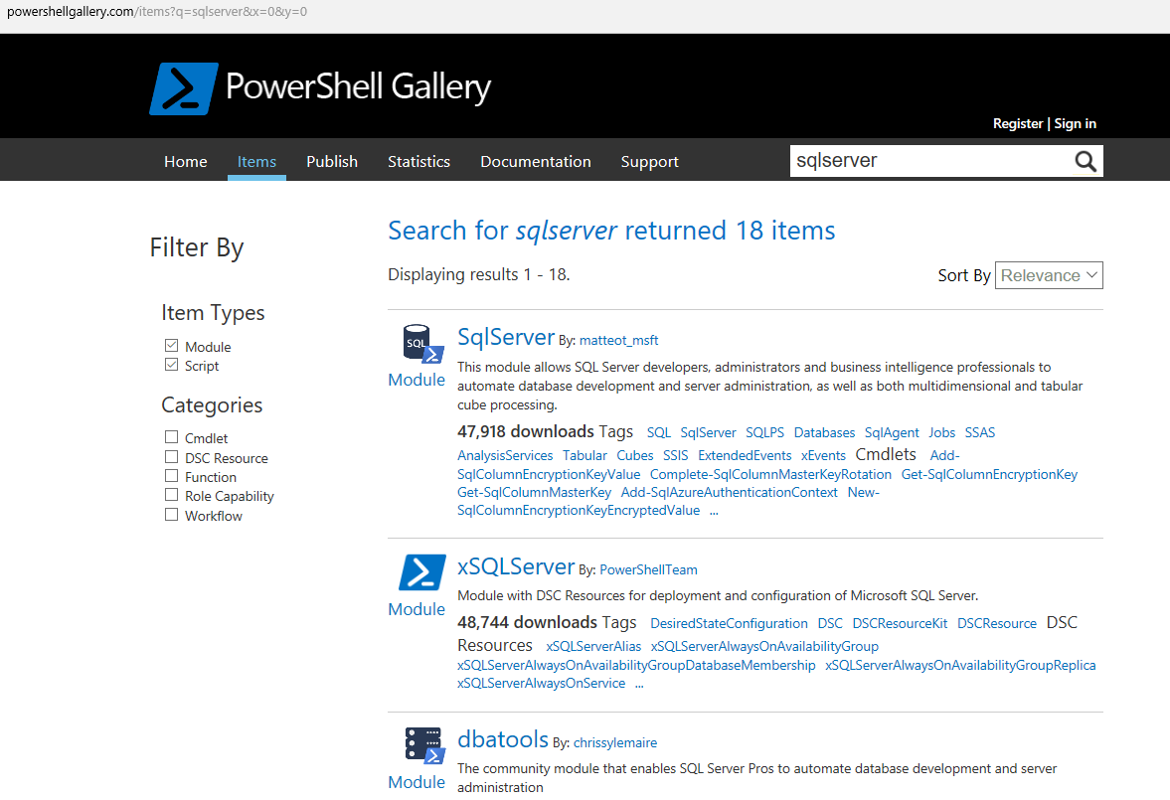
Notes:
Replace with SQLServer search

Slide 26
Some Modules
AzureRM ( 1773 cmdlets )
VMWare ( 623 )
Exchange
SharePoint
Active Directory ( 147 )
WebAdministration (IIS) ( 71 )
SQL Server ( 98 )
Dbatools ( 378 )

Slide 27
Execution policy
Safety ≠ Security
Get-ExecutionPolicy –List
Via GPO !
Restricted
Allsigned
Remotesigned
Unrestricted
Bypass
(Undefined)

Slide 28
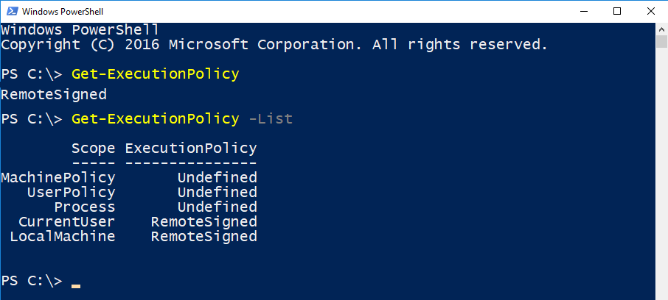

Slide 29
sqlps.io/gpo

Slide 30
Profile(s)
$Profile | Format-List –Force
= just a script
Set variables
Load functions
Configure host
Save credentials
…

Slide 31
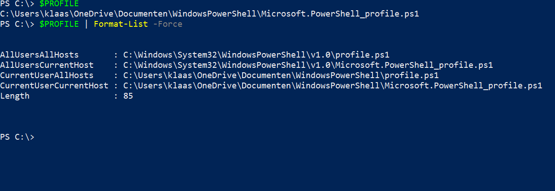

Slide 32
Objects
CIM -> DMTF standard
Windows: WMI
OO: .Net, SMO
Live connection to an object
<> text representation
=> apply methods
≈ Query window in SSMS
PSObject wrapper

Slide 33
The pipeline
≈ assembly line
Objects in Pipeline = PowerShell Heresy
Don’t build collections!
Begin {} Process {} End {}

Slide 34
Remoting
Connecting to multiple computers like to multiple SQL Servers with SSMS
Windows PowerShell supports remote computing by using various technologies
WMI
SQL WMI
RPC
WS-Management
Notes:
Microsoft’s recommended way to manage Windows
By default, only allows connections from members of the Administrators group
Single port 5985 or 5986
Uses the Web Services for Management (WS-Management) protocol
Regardless of the transport protocol used (HTTP or HTTPS), PowerShell Remoting always encrypts all communication after initial authentication with a per-session AES-256 symmetric key
Initial authentication is NTLM, Kerberos and Certificates so no credentials are ever exposed

Slide 35
Modules for the DBA
SqlServer, formerly SQLPS
dbatools
SQLDiagAPI
PowerUpSQL
Go to powershellgallery.com and search for SQL Server

Slide 36
Working with SQL Server
Manage computers
Network PageFile Scheduled Tasks
AD PowerPlan PerfMon
OS Local Admins WinEvents
Disks secpol Firewall
Manage Data
Manage SQL Server
Modules: sqlserver, dbatools
SQL Management Objects (.NET & PowerShell)
SQL Provider:\>_

Slide 37
SQLSERVER:\>_
Introduction to the SqlServer Provider

Slide 38
What is it?
The SQL Server provider exposes the hierarchy of SQL Server objects in paths similar to file system paths.
You can use the paths to locate an object
You can use methods from the SQL Server Management Object (SMO) models to perform actions on the objects.
sqlps.io/provider

Slide 39
How can I get it?
On the client machine you need to have the SQL Server Management Objects
One way - install latest SSMS from sqlps.io/dl

Slide 40
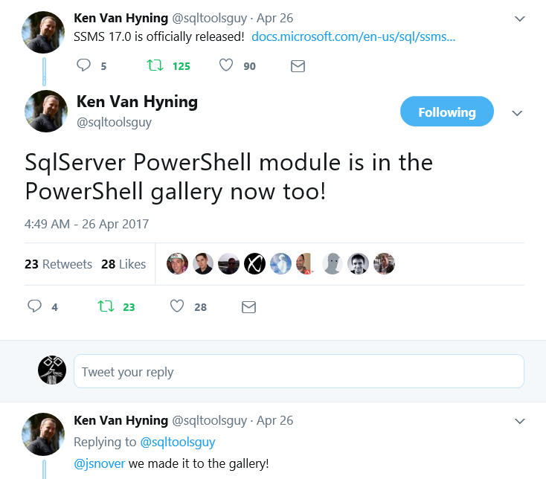
How can I get it? – This is the BEST way
From the PowerShell Gallery*
Install-Module sqlserver

Slide 41

What Can I Do?
It‘s
PowerShell
☺

Slide 42

Enough Chat Beardy – Show us some Code!
Demo

Slide 43
Summary
SQL Server Provider enables you to navigate SQL Server like its a file structure
It‘s just PowerShell and just SMO – Use Get-Member to find the methods
There is no SSRS – Install-Module ReportingServicesTools
dbatools is awesome!

Slide 44

intro to dbatools
Born in !

Slide 45
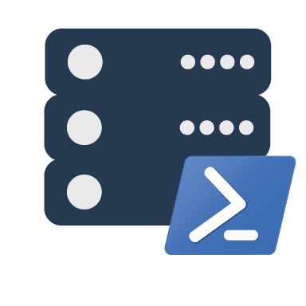
dbatools

Slide 46
Support
SQL Server 2000 – 2017
Express – Enterprise Edition
Clustered and stand-alone instances
Windows and SQL authentication
Default and named instances
Multiple instances on one server
Notes:
Started as a migration tool, so I strived to support older environments
No reliance on SQLPS, because we’ve got a history ;)

Slide 47
System Requirements
Minimum
Client
PowerShell v3
Server
SQL Server 2000
No PowerShell for pure SQL commands
PowerShell v2 for Windows commands
PowerShell remoting enabled for Windows commands
Recommended
Client
PowerShell v5.1
Server
SQL Server 2008R2+
Notes:
Started as a migration tool, so I strived to support older environments
No reliance on SQLPS, because we’ve got a history ;)

Slide 48
Install is easy
PowerShell Gallery
Install-Module dbatools
Install-Module dbatools –Scope CurrentUser
GitHub – dbatools.io/git
Invoke-Expression (Invoke-WebRequest https://dbatools.io/in)
Offline installer
dbatools.io/offline
Notes:
Gallery requires admin access and is built into PowerShell v5. Other versions also support it with a bit of configuration.
Download
Unzip
Import-Module

Slide 49

So easy

Slide 50
How to Get-Help
Extensive documentation within each command Get-Help Start-DbaMigration –Detailed
Extensive documentation on dbatools.io
dbatools.io/Start-DbaMigration
dbatools.io/Repair-DbaOrphanUser
Some commands have videos
dbatools.io/youtube

Slide 51
demo
demo

Slide 52

Lunch

Slide 53
PowerShell in Practice: Gather Your Servers
Automating the collection of your SQL Instances
Notes:
Automating the collection of your SQL Instances,
so you can use them everywhere in the blink of an eye.

Slide 54
PowerShell imports all types of files:
.txt
.csv
XML
JSON
.xlsx

Slide 55
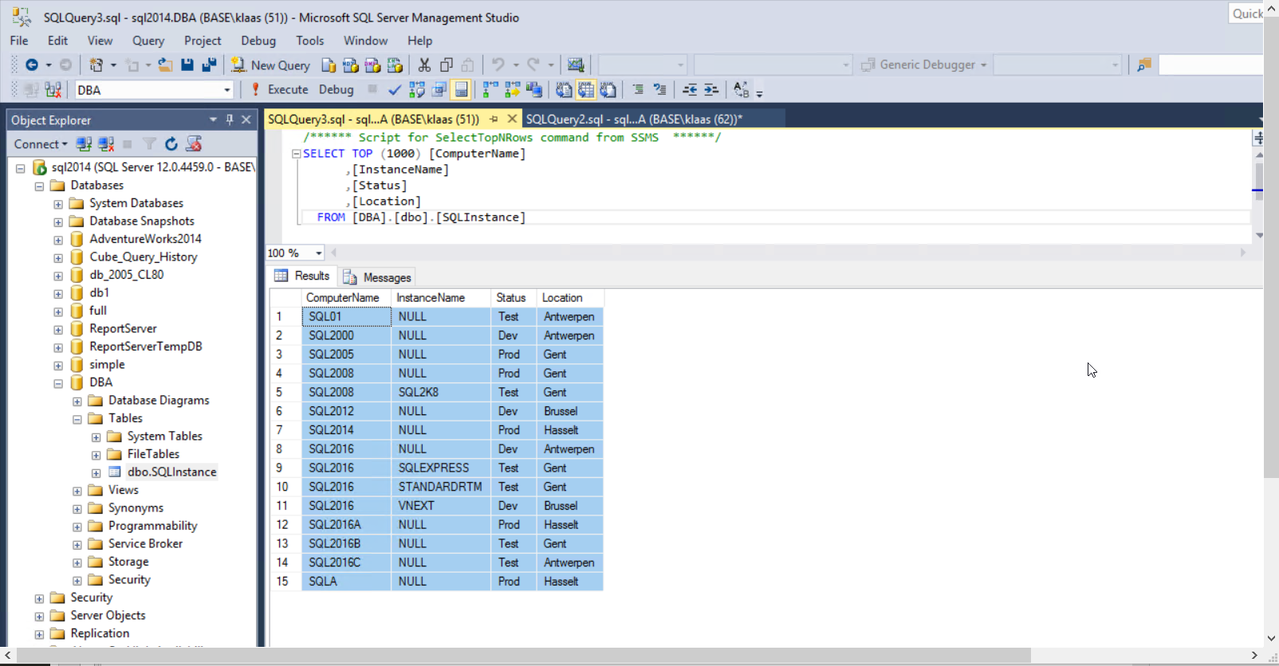

Slide 56
demo
Gather your Servers
demo

Slide 57
Profile
One profile or multiple?
Code in the profile or in a resource file, dotsourced?
Filtered collections ($MyProdSQLInstances, $SQLHostsInGent,…) or 1 global array with properties to filter on?
Static collection (.txt or .csv) or dynamic (registeredserver, AD,…)?

Slide 58
PowerShell in Practice: Checking SQL Server Through the Ages
with PowerShell, of course

Slide 59
My story ( yours too ? )
Congratulations, you’re our new DBA
Where are those SQL Servers
How do I connect?
What should I check?
SSMS

Slide 60
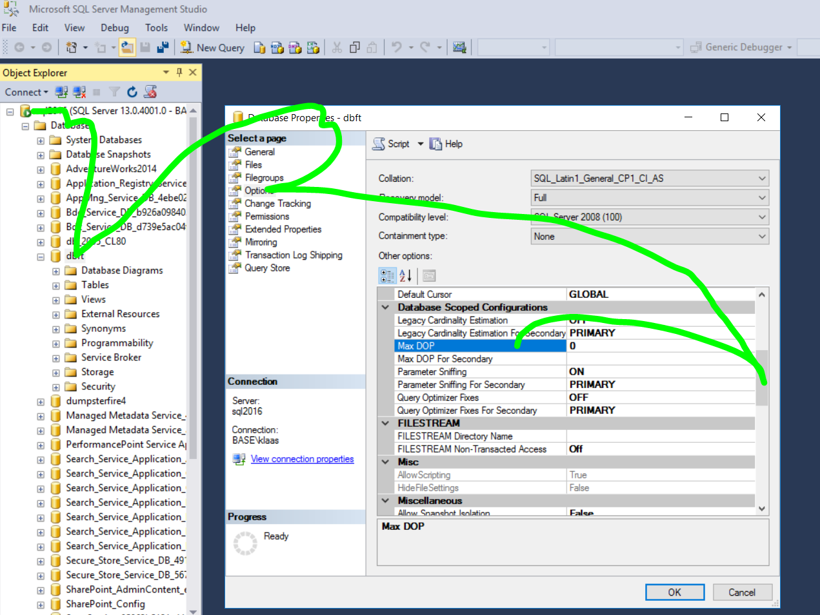

Slide 61
Give me my PowerShell
PS v1, remember?
No dbatools
No modules
No ISE
SQLPS, yeah, but …
.Net
SMO
connect
navigate
get property
… compare

Slide 62
Types of checks
Based on checking interval
Monitoring
every . minutes
alerting
ex services running, diskspace, watch-dbalogons, …
Scheduled checks
hours / daily
save and build history
ex DB size, job duration
Ad hoc
troubleshooting
pre-checks ( for updating, migrating, reconfiguring,…)

Slide 63
Ad hoc
Fire!
Fast
Priorities
Brent Ozar: First Responder Kit
Glenn Berry: Diagnostic DMV
Jonathan Kehayias: Troubleshooting SQL Server
Rodney Landrum: SQL Server Tacklebox
…
Visual
red – green
console output

Slide 64
demo
Check-SqlInstance 2011
demo

Slide 65
demo
Checking with dbatools functions
demo

Slide 66
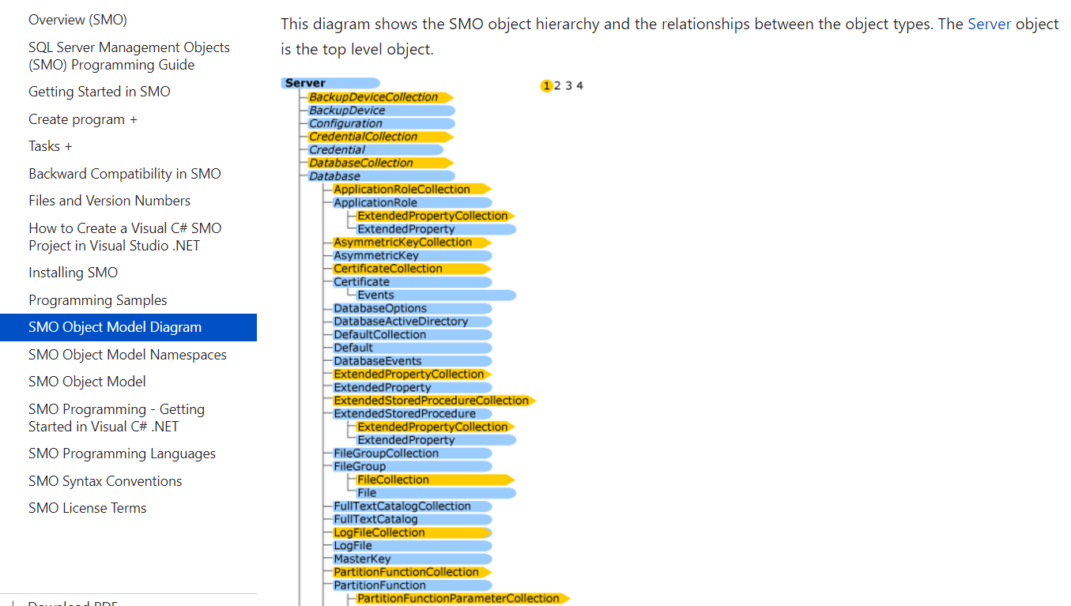
SMO Object Model
sqlps.io/smo

Slide 67
demo
Navigate through SMO
demo

Slide 68
Daily checks
Send by e-mail
Save to DB
Create HTML, csv
Power BI
Did all agent jobs succeed?
Are all the backup files there?
What appeared in the error log?
Did any permissions change?
(AD group membership changes too!)
What are the DB sizes today?

Slide 69
Examples
A bit of inspiration
Sqlinfodb
Jobs email
Jobs google timeline
PP-sqlinfodb

Slide 70
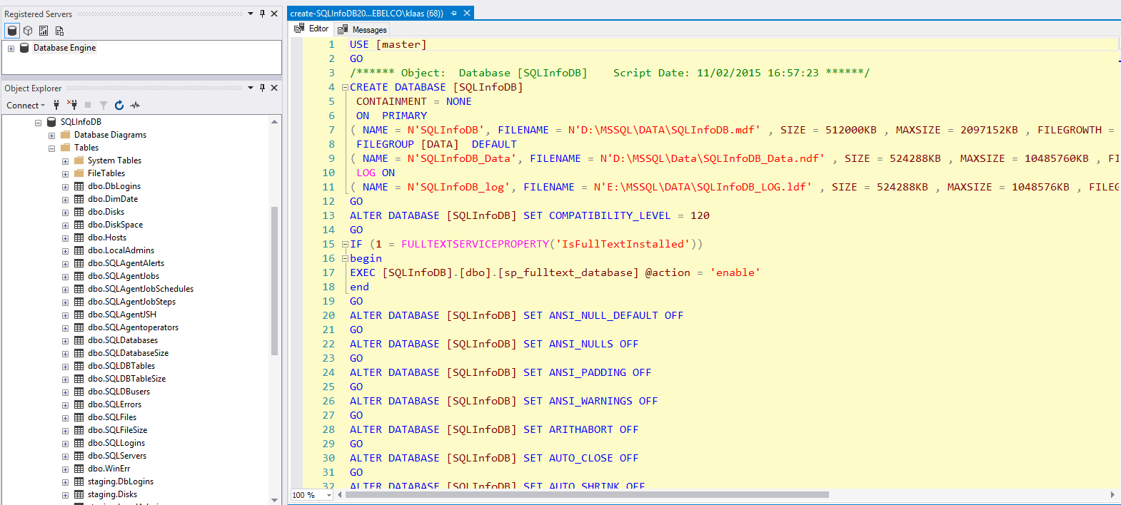

Slide 71
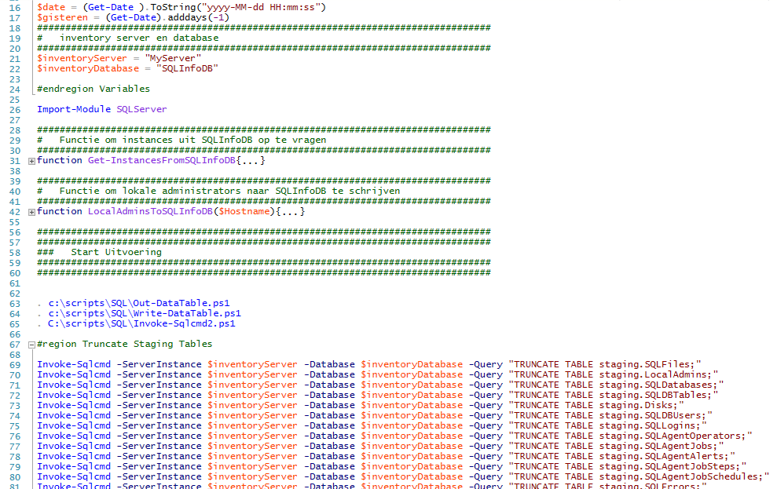

Slide 72
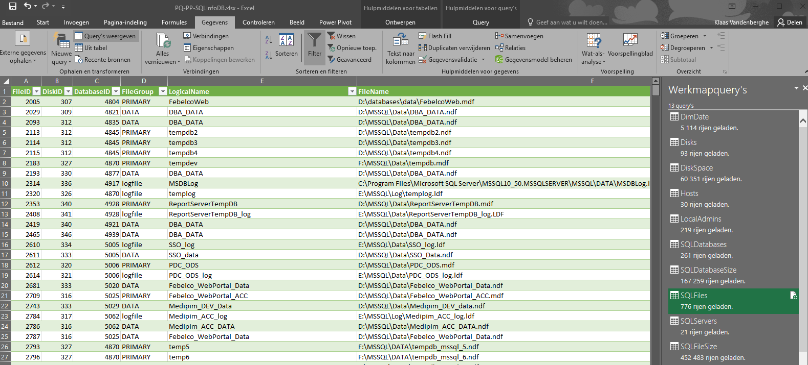

Slide 73
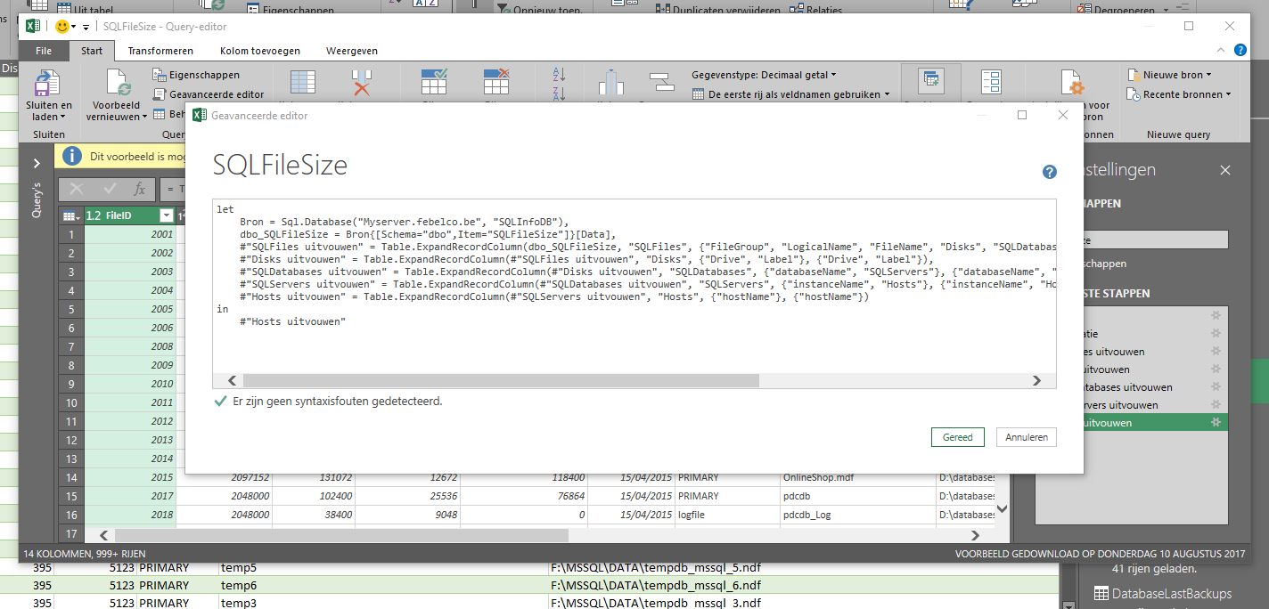

Slide 74
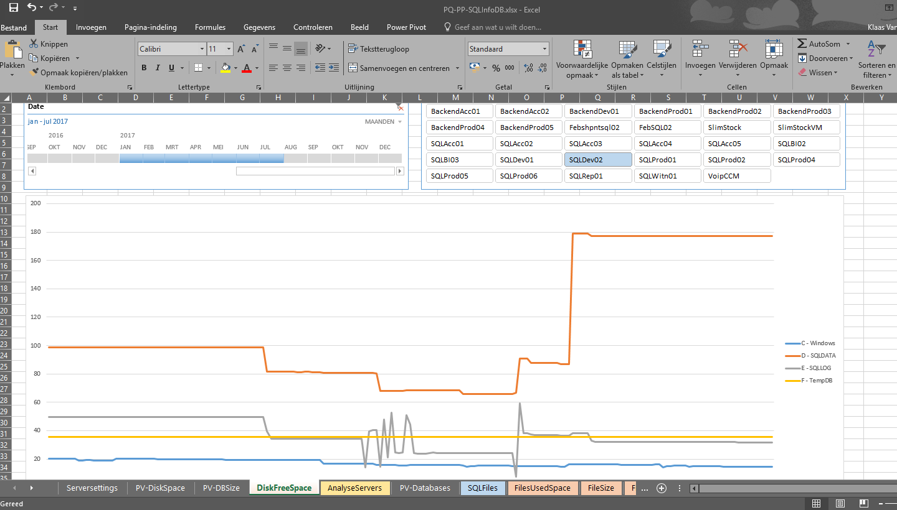

Slide 75
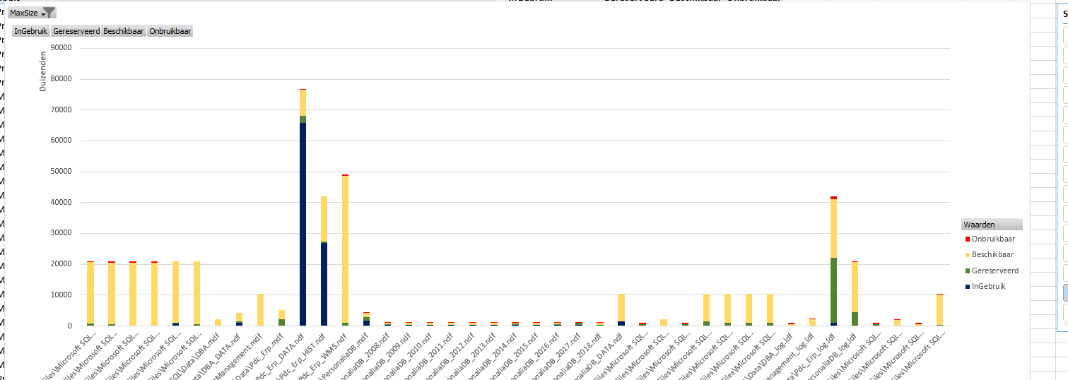

Slide 76
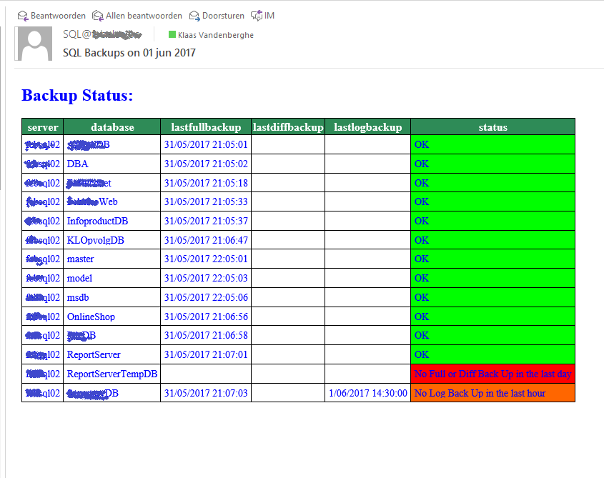

Slide 77
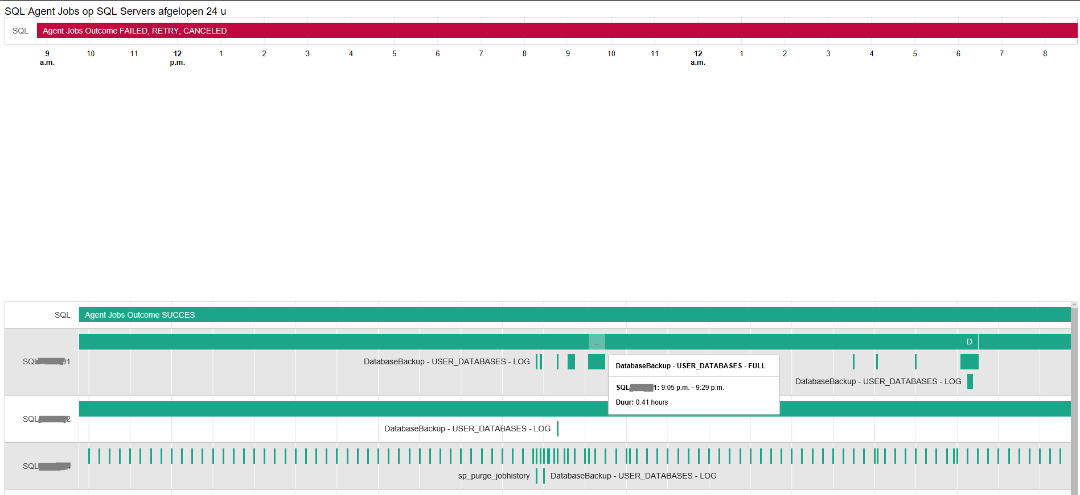

Slide 78
monitoring
Every move you-ou make … ♫
Perfmon
WMI events
Extended Events
Scheduled tasks with short interval

Slide 79
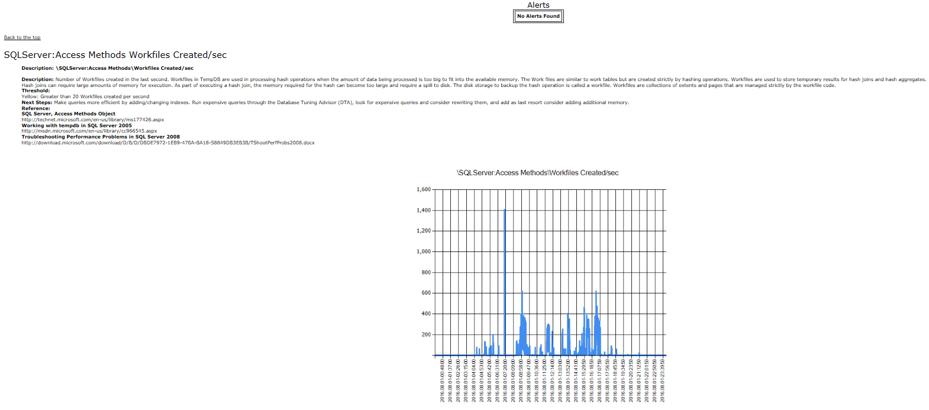
PAL
Performance Analysis of Logs

Slide 80
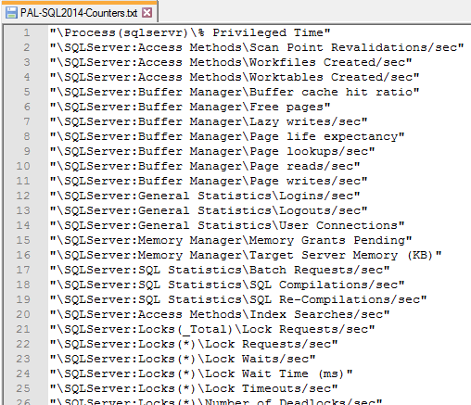

Slide 81
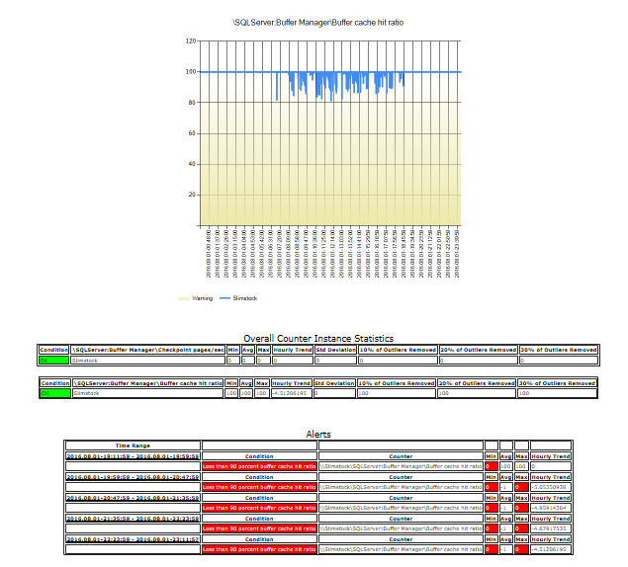

Slide 82
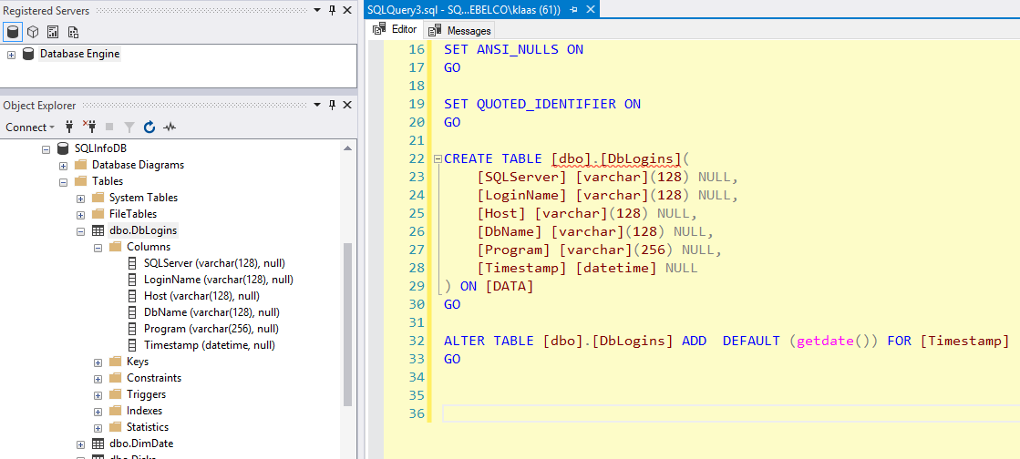
Watch-DbaLogins

Slide 83
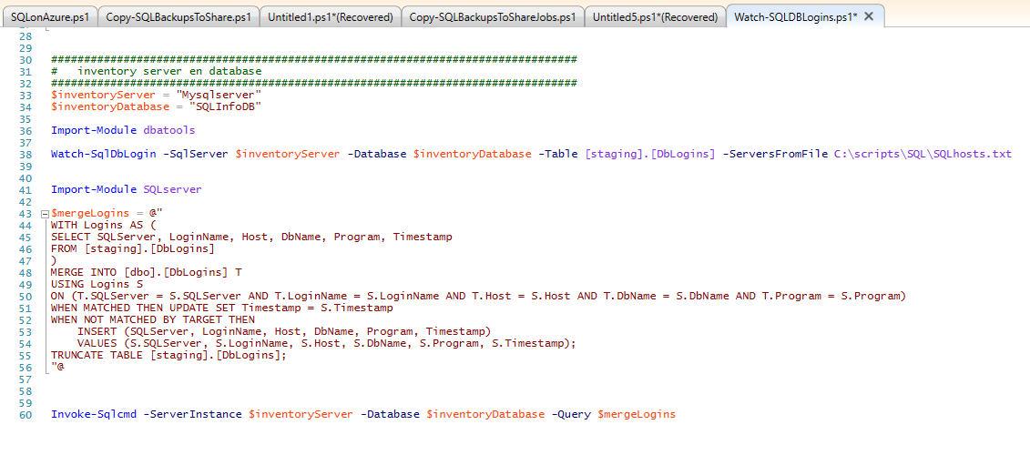

Slide 84
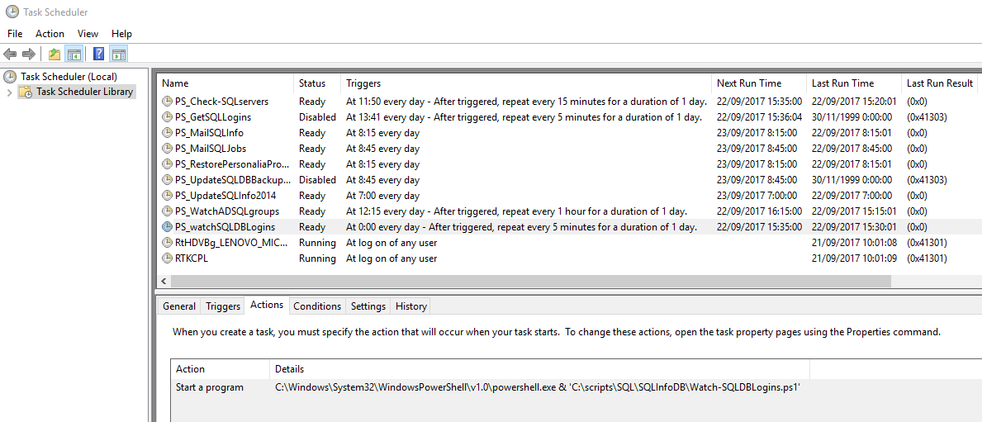

Slide 85
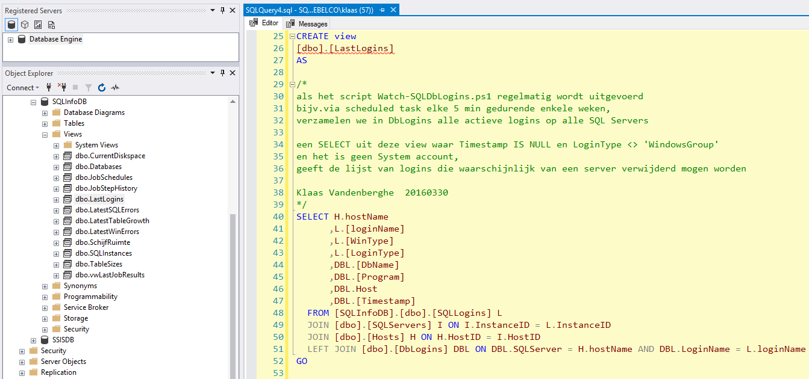

Slide 86
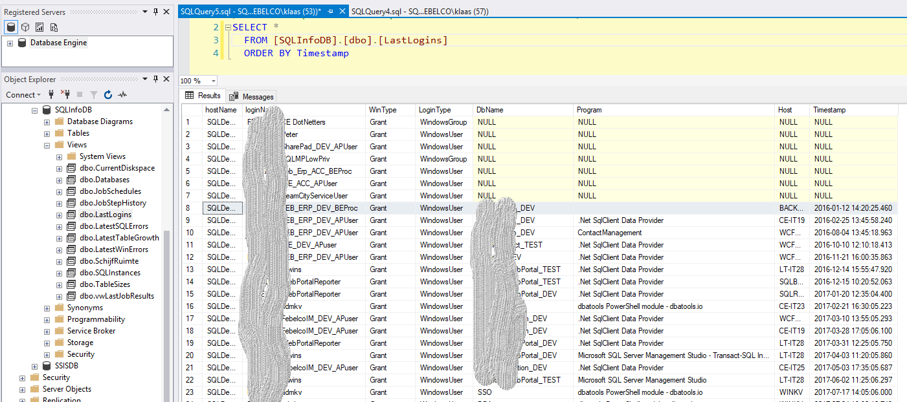

Slide 87
To be continued …
Next year you can be presenting on …
Replace existing solutions with dbatools functions
Make scripts portable: use parameters, verbose,…
Compose intelligent scripts
Start-DbaDiagnosis

Slide 88
PowerShell Pester in Practice: Checking your SQL Servers Right Now
with Pester, of course

Slide 89
TODAY’s TO DO LIST
GET UP
Drink Appropriate Liquid
The Rest

Slide 90
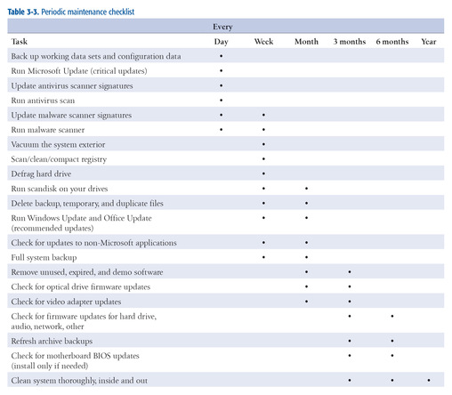
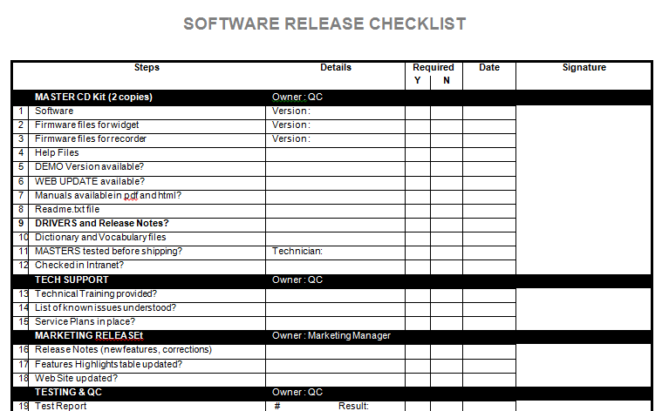
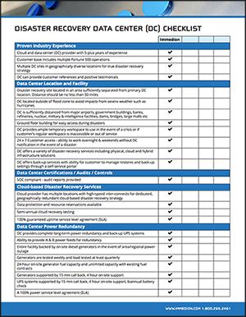
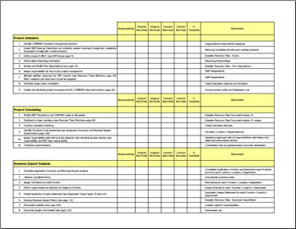
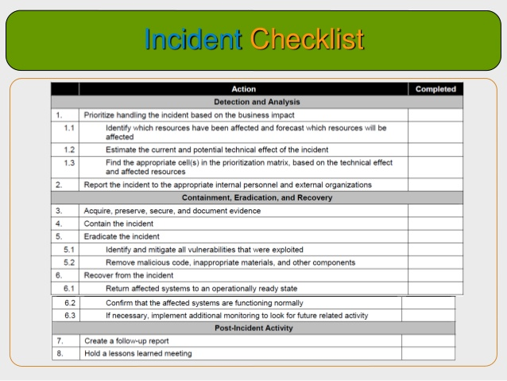
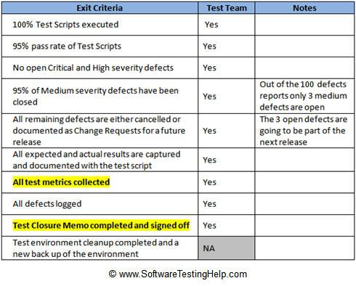
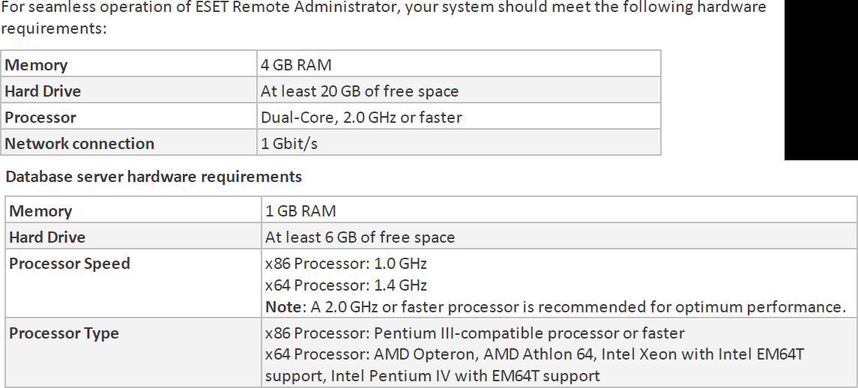
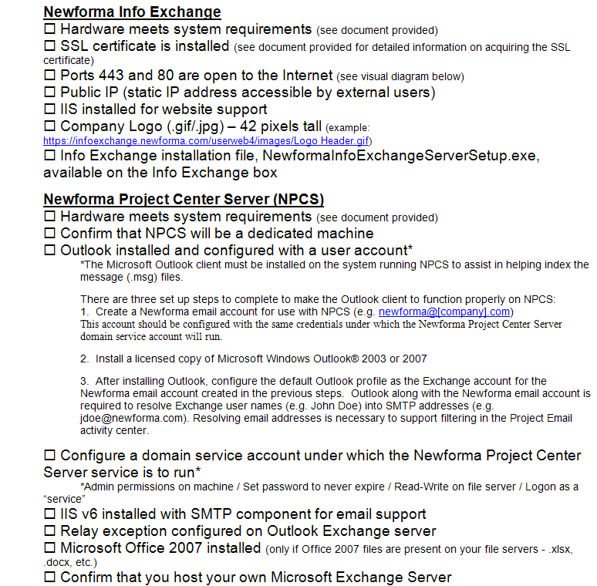
How Many Checklists Do You Have?
Notes:
I bet there are checklists for
New servers/ data centers
Hardware/software installations
Incident Response
1st Line/2nd line for systems
Pre-requisites
Morning routines

Slide 91
What about
Demos
Presentations
Morning Checks
Incident Response
First Line Support
I‘m sure you are already thinking of more

Slide 92
What is Pester?
Pester provides a framework for running unit tests to execute and validate PowerShell commands from within PowerShell
sqlps.io/pester
Notes:
Its used for unit testing or TDD but can also be used to validate an environment. Comes with Windows 10 or install from the gallery with Install-Module Pester

Slide 93
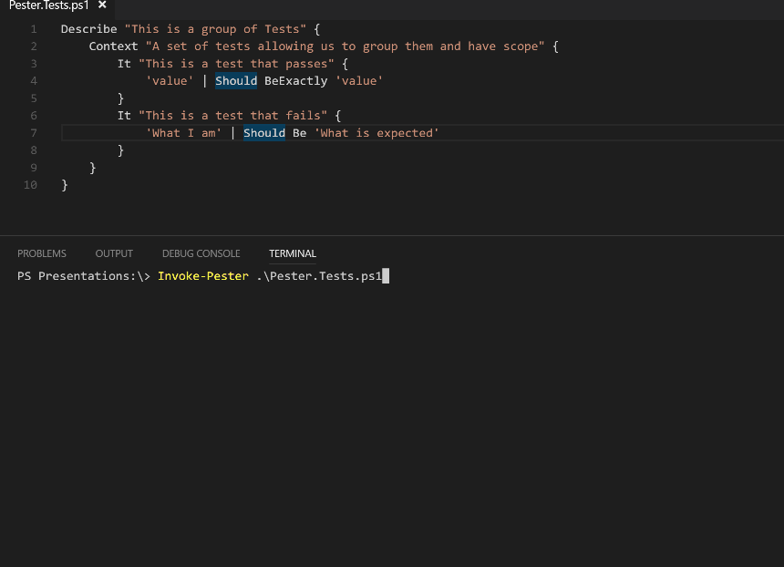
What Does it Look Like?
Notes:
This is a Pester test running in VS Code

Slide 94

I’m Sorry!

Slide 95
Should Operators
Be Compares one object with another for equality. Case Insensitive BeExactly Compares one object with another for equality. Case Sensitive BeGreaterThan Asserts that a number is greater than an expected value. BeLessThan Asserts that a number is less than an expected value. BeLike Asserts that the actual value matches a wildcard pattern using -like operator. Case Insensitive BeLikeExactly Asserts that the actual value matches a wildcard pattern using -like operator. Case Sensitive BeOfType Asserts that the actual value should be an object of a specified type Exist Does not perform any comparison but checks if the object calling Exist is present in a PS Provider. Contain Checks to see if a file contains the specified text. Case Insensitive ContainExactly Checks to see if a file contains the specified text. Case Sensitive Match Uses a regular expression to compare two objects. Case Insensitive MatchExactly Uses a regular expression to compare two objects. Case Sensitive Throw Checks if an exception was thrown in the input ScriptBlock. BeNullOrEmpty Checks values for null or empty (strings).
I Hate slides with lots of text but I think this one is valid

Slide 96

So What Can You Validate?
Notes:
Everything in the world ☺

Slide 97
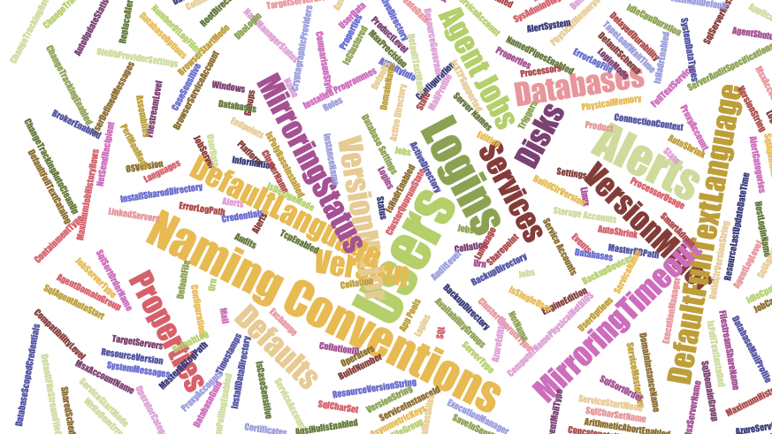
Maybe not EVERY thing but anything you can check with PowerShell

Slide 98

Maybe not EVERY thing but anything you can check with PowerShell
Which Does NOT include
Describe “Bag Packing” {
Context “Hardware”{
It “Bag Should include BeardNUC” {
$bag.Contents –contains ‘beardnuc’ | Should Be $True
}
}
}
I have no virtual machines with me here!
dumskalle!

Slide 99

Hey Beardy!
Time For A DEMO

Slide 100
Summary
We all have checklists – manual testing is error-prone
Pester is a Unit Testing Framework for PowerShell
You can use it to validate your infrastructure
The basic syntax - Describe, Context and It code blocks
The Should command is used for testing assertions
Use the NunitXML output and the reportviewer.exe to make HTML reports or Export to JSON and use PowerBi

Slide 101
dbatools development in practice
The story of Get-DbaWaitStatistic

Slide 102
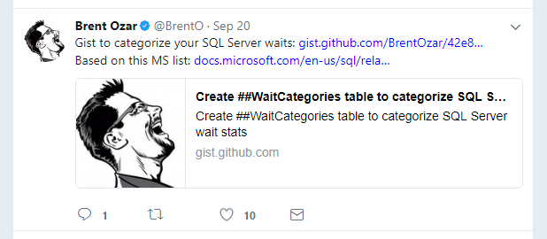
Get-Inspired
(usually Twitter..)
Notes:
From Tweet to gist
From gist to dropbox
From dropbox to Google to SQL Skills
Then to templates

Slide 103
The rest
Google a bit
Grab the appropriate template from dbatools.io/template
Is it T-SQL based? Make decisions
Output unprocessed query (fastest)
Add some fancy PowerShell calculations (more robust)
Contemplate Parameters
Create v1
Test against lower versions
Create a Pester test

Slide 104
demo
demo

Slide 105
sql powershell administration in practice
Scheduling PowerShell tasks in SQL Server Agent

Slide 106
PowerShell & the SQL Server Agent
PowerShell Job Step
sqlps.exe
Version varies by SQL Server version
Doesn’t always work as expected
CmdExec Job Step
powershell.exe via cmd.exe
Version is always the system version
Often (always?) works as expected

Slide 107
PowerShell & the SQL Server Agent
Create a Windows-based Login in SQL Server
Ensure dbatools is available to the account
Create a SQL Server credential
Create the Agent Proxy
Create the PowerShell .ps1 file
Create the Job and Job Step
Schedule the Job

Slide 108
demo
demo

Slide 109
dbatools.io/agent

Slide 110










Thanks to our sponsors!

Slide 111
Resources

Slide 112
PowerShell books
PowerShell in Depth 3rd, Payette & Siddaway, 2017, Manning
Windows PowerShell Cookbook 3rd, Lee Holmes, 2013, O’Reilly
The PowerShell Scripting and Toolmaking Book, Don Jones & Jeff Hicks, 2017, Leanpub
Learn PowerShell in a Month of Lunches 3rd, Don Jones & Jeff Hicks, 2016, Manning
Windows PowerShell in Action 3rd, Bruce Payette & Richard Siddaway, 2017, Manning
Getting started with PowerShell, Michael Shepard, 2015, Packt Publishing
Exploring PowerShell Automation, Richard Siddaway, 2016, Manning
PowerShell in Depth 2nd, Don Jones & Richard Siddaway & Jeff Hicks, 2014, Manning
www.powershell.org/ebooks

Slide 113
PowerShell for SQL Server books
PowerShell for SQL Server Essentials, Donabel Santos, 2015, Packt Publishing
SQL Server 2014 with PowerShell v5 Cookbook, Donabel Santos, 2015, Packt
Notes:
SQL Server 2008 Administration with Windows PowerShell, Yan Pan & The MAK, 2009, Wiley Publishing << VBScript Style Syntax, not recommended.
Same for Donabel’s older book

Slide 114
Who to follow - PowerShell Community
PowerShell
June Blender
Stephen Owen
Boe Prox
Carlos Perez
harmj0y
Kirk Munro
Dave Wyatt
Hey, Scripting Guy
Jeffrey Snover
Don Jones
Jeffery Hicks
Richard Siddaway
Bruce Payette
Lee Holmes

Slide 115
Who to follow - SQL PowerShell Community
PowerShell for SQL Server
PASS PowerShell VC
Claudio Silva
Mike F. Robbins
Max Trinidad
Aaron Nelson
Warren Frame
Ben Miller
Amit Banerjee
Ken Van Hyning
Matteo Taveggia
Mike Fal
Shawn Melton
Constantine Kokkinos
Fred Weinmann
Sander Stad
André Kamman
Stuart Moore
Chris Sommer
Drew Furgiuele
Garry Bargsley

Slide 116
Remoting
Some commands require no remote configuration, including
Restart-Computer
Get-Process
Get-Service
Get-WinEvent
“Remoting” refers to commands that use WS-Management
Microsoft’s recommended way to manage Windows
Administrator access only - by default
Web Services for Management (WS-Management) protocol
HTTP or HTTPS, but neither expose credentials
Notes:
Microsoft’s recommended way to manage Windows
By default, only allows connections from members of the Administrators group
Single port 5985 or 5986
Uses the Web Services for Management (WS-Management) protocol
Regardless of the transport protocol used (HTTP or HTTPS), PowerShell Remoting always encrypts all communication after initial authentication with a per-session AES-256 symmetric key
Initial authentication is NTLM, Kerberos and Certificates so no credentials are ever exposed

Slide 117
dbatools.io/contributing

